Slide 1
Code of Conduct
Incident Response Training
Please change your Zoom name
to include your pronouns
(if you're comfortable sharing them)
It's under Participants, hover over your name,
click rename
CC NC-BY-SA
Otter Tech LLC
sharp@otter.technology

Slide 2
Introductions:
Name
(Optional) Pronouns you use
What events or communities
you enforce a Code of Conduct in

Slide 3
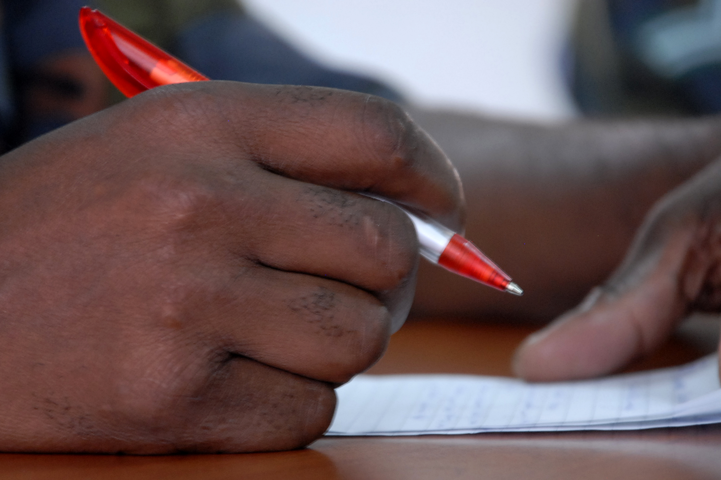
Vocabulary
Code of Conduct incident
Reporter
Reported person
Third party witness
Incident Responder
CC BY U.S. Army Africa

Slide 4
Agenda
Incident responder duties
Taking an incident report & paired practice #1a
Evaluating a report
Following up on a report & paired practice #1b
Taking an incident report practice #2a
Group report evaluation
Following up on a report practice #2b

Slide 5
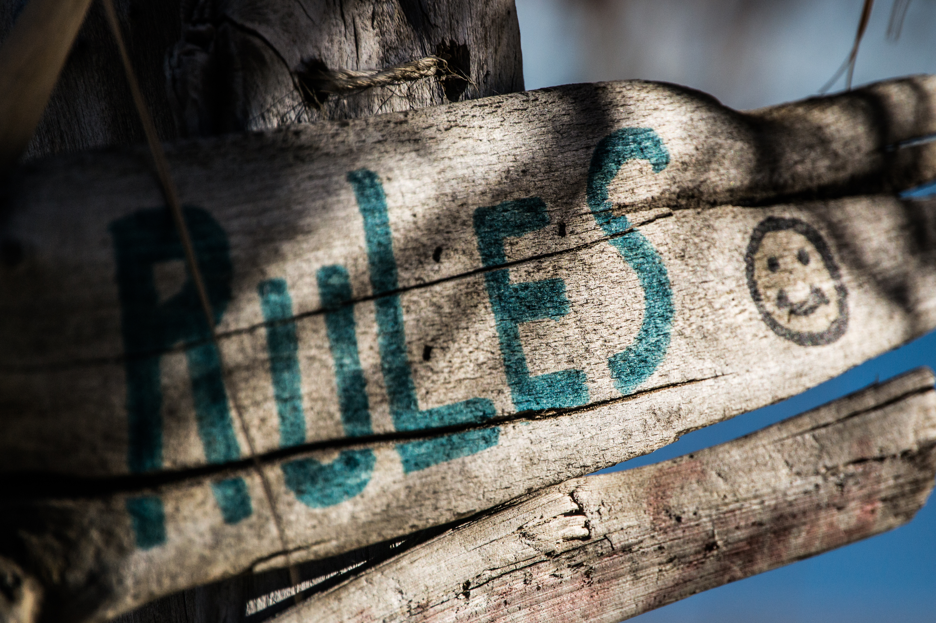
Ground Rules
This is a safe(r) space
If you are asked to stop, you will stop
You may leave at any time
Be open to new knowledge
Acknowledge different lived experiences
CC BY Steve Johnson

Slide 6
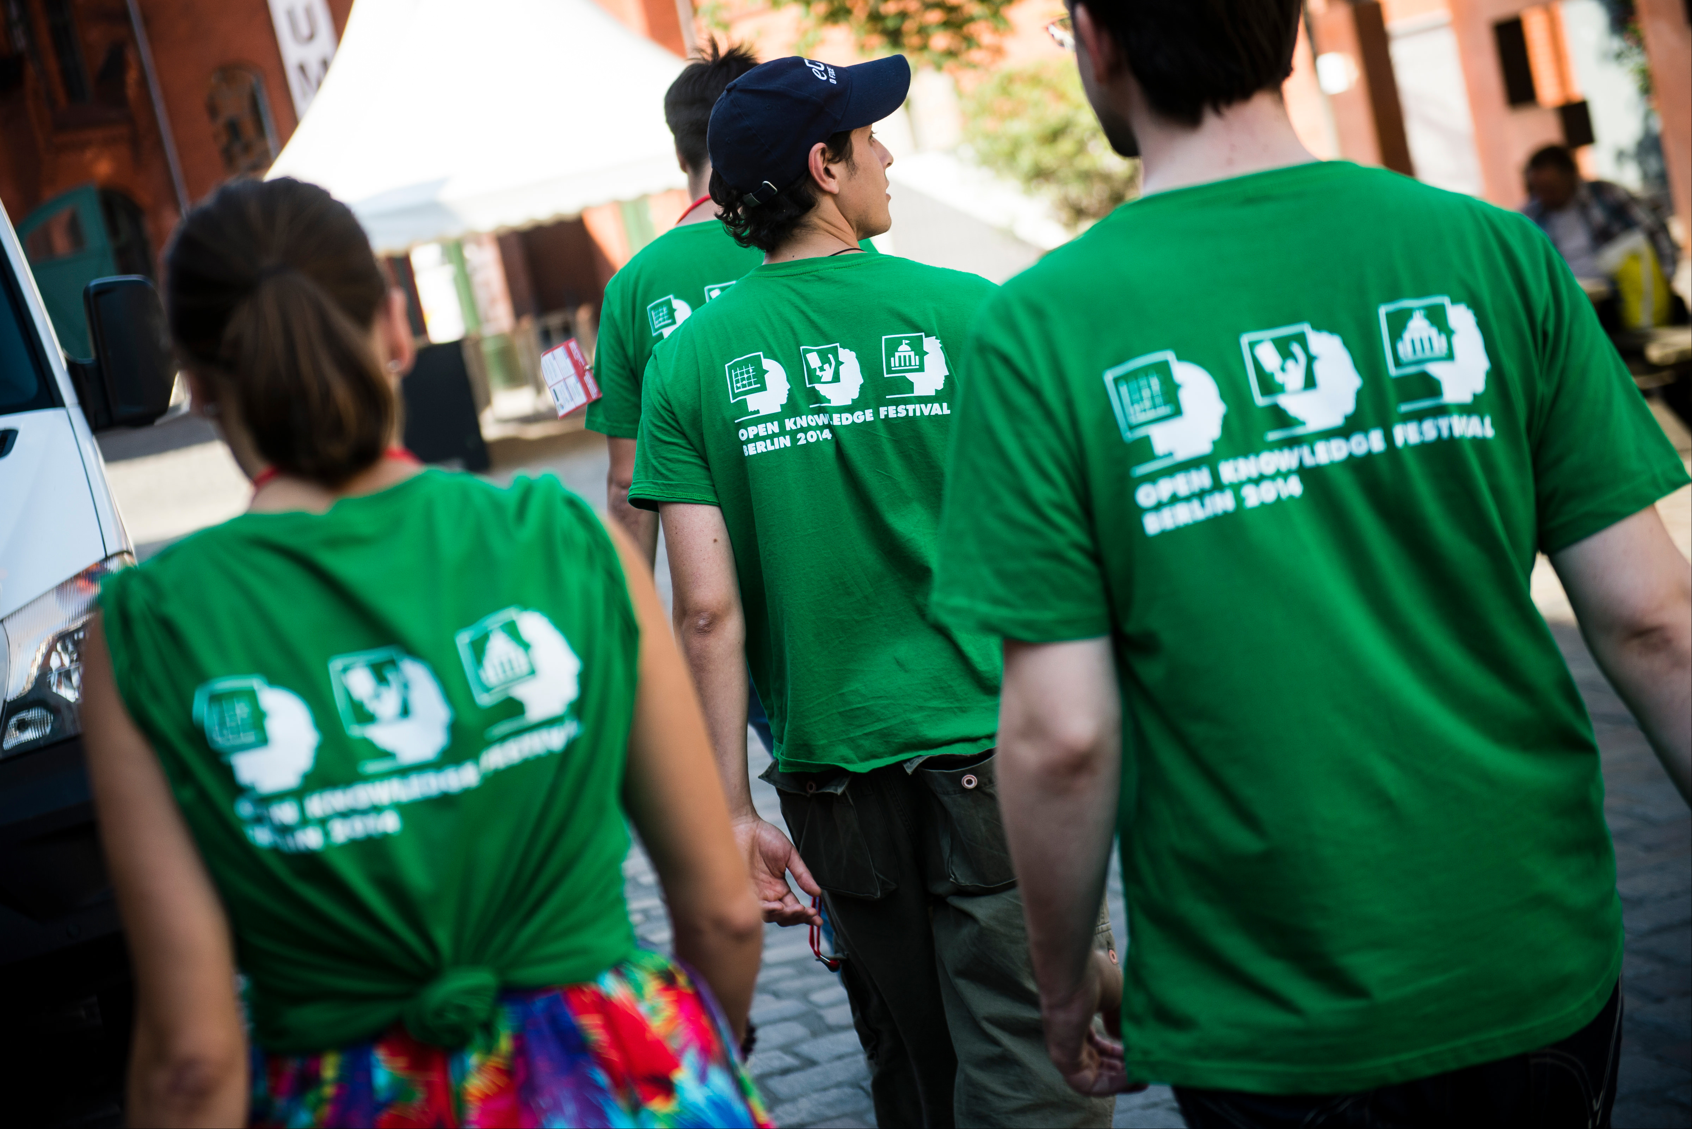
Incident Responder Duties
Takes incident reports
Protects reporter privacy
Assesses the situation
Finds additional help
Resolves the incident
Responds to those impacted
Documents the incident
CC BY Open Knowledge

Slide 7
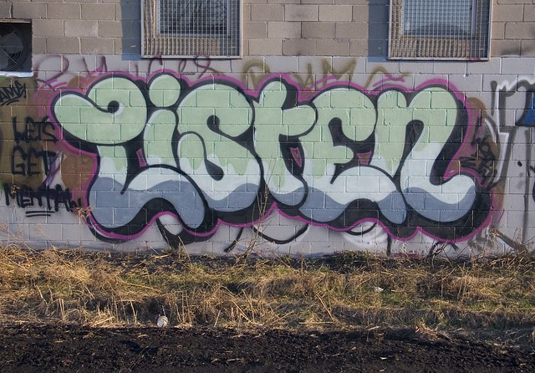
Common Reporter Needs
+ To be heard
+ To be respected
+ To feel safe
~ To create meaning
- To be "right"
- Justice or vengeance
CC BY painteverything

Slide 8
Acknowledging Reporter Emotions
"You felt (emotion) when (behavior)."
Example: "You felt scared when they raised their voice."
Softening the directness:
"So you felt..."
"It sounds like you felt..."
"I'm hearing that you felt..."
"Nonviolent communication" by Marshall B. Rosenberg, PhD

Slide 9
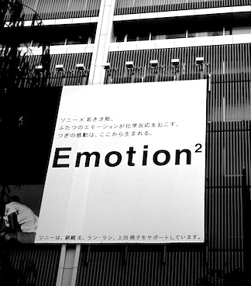
Common Reporter Emotions
Repeating themselves
Becoming flustered
Talking fast
Judgment words
Anger
Mistrust
Emotion CC BY 2.0 Osamu Kaneko

Slide 10
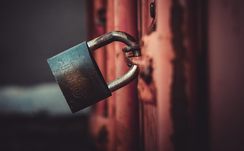
Handling Privacy Concerns
Report will be confidential
Take an anonymous report
Tell reported person a witness overheard / saw
Take an escrow report
Document report
Act after second report
Delay response to protect privacy of 2nd person
Don't mention multiple reports
Locked CC BY 2.0 montillon.a

Slide 11
Report Template
Most important:
Reported person's name and description
Reporter's contact info
Key points of the incident
Tips section
Optional information
Don't ask how you should handle the situation
Link to download report template

Slide 12
Taking an Incident Report: QUEST
Quiet place - offer a private room / private chat
Unsafe - call another incident responder
Emotions - "You felt (emotion) when (behavior)"
Security - how to protect reporter privacy & safety?
Trust - help the reporter feel more welcome
Thank the reporter. Get their contact info.

Slide 13
Instructor modeling
taking a report

Slide 14
Practice
Receiving Reports

Slide 15
Discussion
For the incident responder:
What was hard, complex, or complicated?
For the reporter:
What did the incident responder do well?
What techniques did they use?
Any effective phrases?

Slide 16
Bias in Receiving Incident Reports
Record the behavior & impact
Don't use "judgment" words
Watch yourself for defensiveness
Be cautious about empathy for reported person

Slide 17



Intent vs. Impact
Intent
behavior

Slide 18

Intent is Not Magic
Action or inaction has impact
Good intent still causes harm
Goal: Stop the behavior
Do they understand why their behavior was inappropriate?
Do they agree to change?
Afterwards: Based on your conversation, does the reporter intend to continue the behavior?
CC BY Fabricio Zuardi
(modified)

Slide 19

Microaggressions: Constant Inequality
Harm caused because your identity is not considered "the default"
e.g. disability, race, gender
May happen daily
Invisible to the "default" identity
Death by 1,000 paper cuts
CC BY Andrew McGill

Slide 20
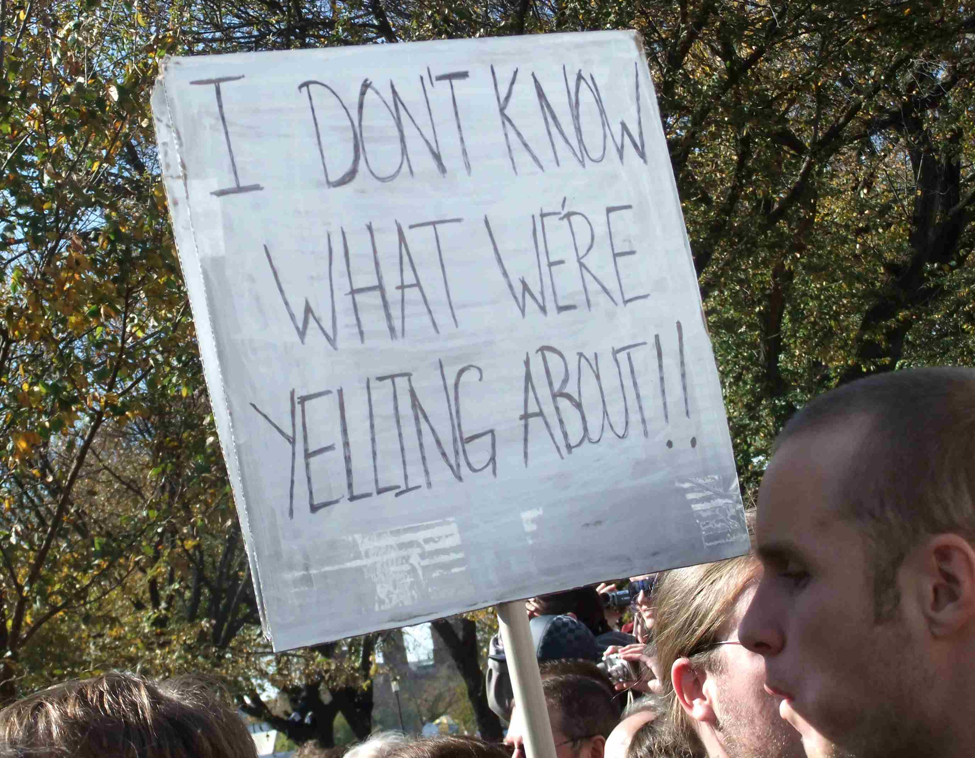
Personal Conflicts
Not all conflicts will be a Code of Conduct violation
Communication breakdown
Is this a pattern?
Know emotional and verbal abuse behaviors: http://outofthefog.website/traits/
CC BY Martha Soukup

Slide 21
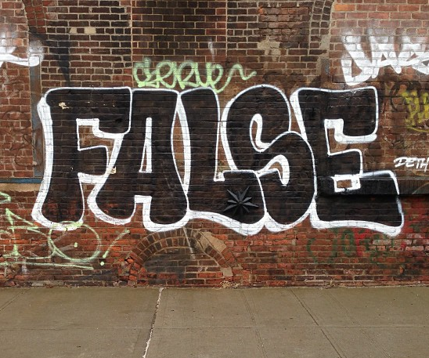
False Reporting: Power Dynamics
What does a reporter have to lose?
Safety
Mental health
Career
Financial support
What does the reported person have to lose?
How likely is it the reporter will lose?
CC BY Adam Lehman

Slide 22
Review All Reports Carefully
Microaggressions & sexual harassment are under reported
Examine the power dynamics
Be cautious of when power dynamic is reversed:
"racism against white people"
"sexist discrimination of men"
other "reverse-isms"
CC BY Adam Lehman

Slide 23
(Break)
Following up on
Incident Reports

Slide 24
Evaluating Reports Risk vs. Impact
Risk:
physically unsafe?
impacts mental health?
risk of behavior being repeated?
Impact:
number of witnesses
authority / leadership of reported person
impact to people from marginalized groups

Slide 25
Evaluating Risk
 | Low Risk | High Risk
Low Impact | Microaggression in conversation Microaggression in private message | Repeated borderline incidents Pattern of verbal or emotional abuse
High Impact | Racist or sexist joke during presentation Inappropriate joke on a public channel | Ongoing harassment or stalking Online harassment campaign or doxxing

Slide 26
Deciding Response
 | Low Risk | High Risk
Low Impact | Issue warning | Monitor and document patterns of behavior, warn or temporary ban, remove from leadership
High Impact | Reprimand, removal of offensive material Public response from staff or organization | Coordinated planning Additional resources Reach out to others

Slide 27
Before Speaking to a Reported Person
Write down:
Their behavior and impact
A behavioral modification plan
Consequences for their behavior (?)
What will happen if they don't agree to modify their behavior?
Who can they appeal the decision to?

Slide 28
Common Emotions for People who have been reported
Emotion | Action
Anger | Defensiveness
Fear | Denial
Humiliation | Blame shifting
Anxiety | Seek reassurance
Disgust | Self blame
Abandonment | Manipulation

Slide 29
Successfully Encouraging Change in Reported People
Goal is to change inappropriate behavior
You will see defensiveness
Reiterate behavior and impact
Focus on shared community goals:
safe, inclusive, welcoming, collaboration, creativity, constructive communication
Offer private ways to practice new skills

Slide 30
Following up with the reported person: BIRDS
Go to a private place / private message or video chat
Have an exit plan. Bring another responder if a ban is likely.
State what their Behavior was without judgment words
State the Impact on the reporter or community
Allow the reported person to Respond
Don't reassure or allow the reporter to be contacted
Set a behavioral modification plan
Offer to relay any apologies
Notes:
“Hi, can I speak with you privately?”
“That's not appropriate.”
“They asked you to stop.”
“This is a private venue.”

Slide 31
Practice:
Following up with
the Reported Person

Slide 32
Discussion
For the incident responder:
What was hard, complex, or complicated?
For the reported person:
What did the incident responder do well?
What techniques did they use?
Any effective phrases?

Slide 33
Following up after an incident
Try to talk to everyone impacted
May need a public statement
Transparency reports
Whisper networks exist
Document the incident
May need to notify volunteers

Slide 34
Q&A

Slide 35
Advanced Topics

Slide 36
Systemic Inequality
Collective lack of action
Biased harmful policies or systems
Negatively impacts marginalized groups
Example: No 'religious symbols' policies
Must choose between a headscarf & education/jobs
2x more Muslim girls don't go to secondary school in France
Source: https://www.washingtonpost.com/politics/2019/06/03/how-will-austrias-new-headscarf-ban-affect-muslims/?noredirect=on

Slide 37
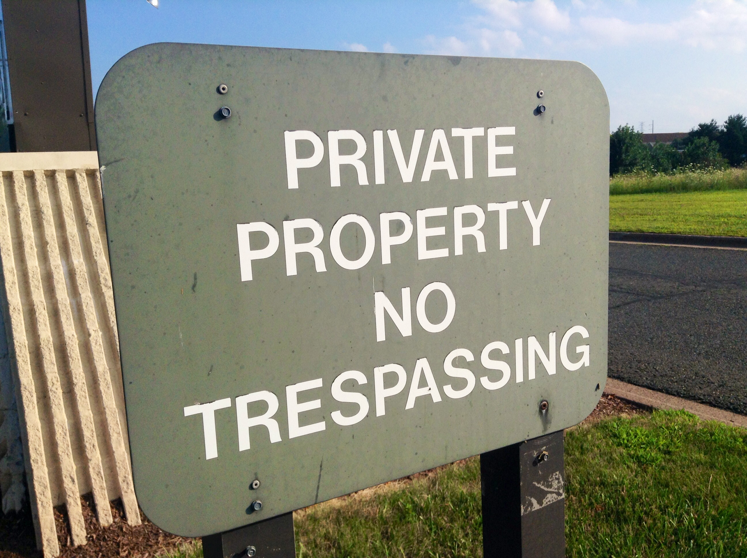
Dealing with Unwelcome Attendees
“You aren’t permitted to attend the conference”
Don’t provide details
Ask them to leave
“This is a private venue”
Get onsite help
Report for trespassing
Know your local trespassing laws
CC BY Mike Mozart

Slide 38
Dealing with Weapons Policy Violations
“Weapons are not allowed at our conference”
Ask them to leave
Come back without the weapon
Do not argue, be firm
Ask staff, response team, security to help
If there is a safety risk, call 911

Slide 39
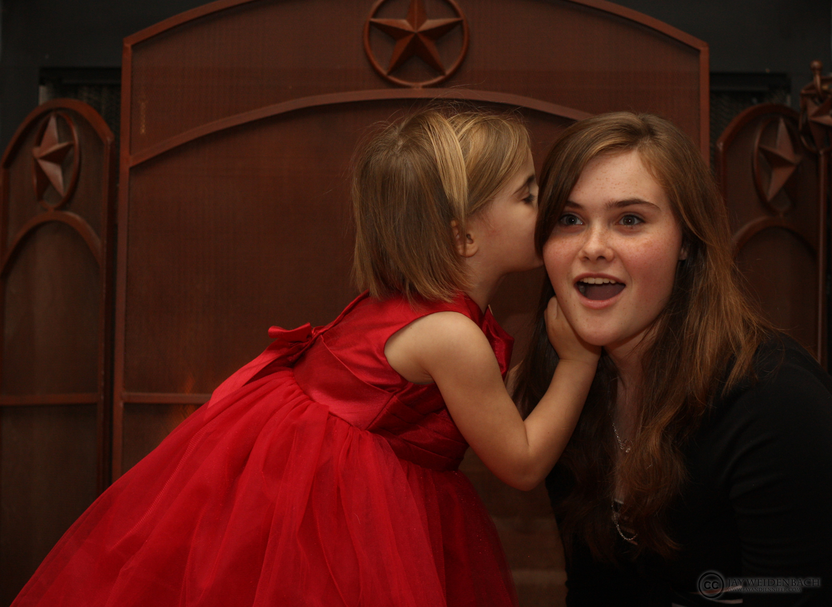
Conflicts of Interest
Is anyone a friend or coworker?
conference staff or volunteers
incident response team
papers committee
sponsors
Review leadership positions for potential leaks:
other incident responders
volunteers & staff
papers committee
board members
CC BY Jay Weldenbach

Slide 40
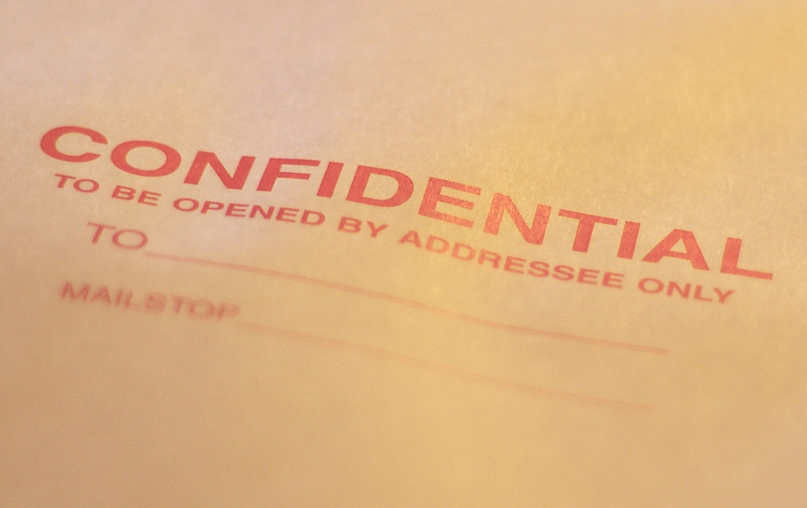
Confidentiality Issues
Reporter fears retaliation
NDAs & severance
Police Investigation
Limit incident docs access
Ask around (discretely)
Often multiple incidents
Other grounds to dismiss
CC BY Casey Marshall

Slide 41
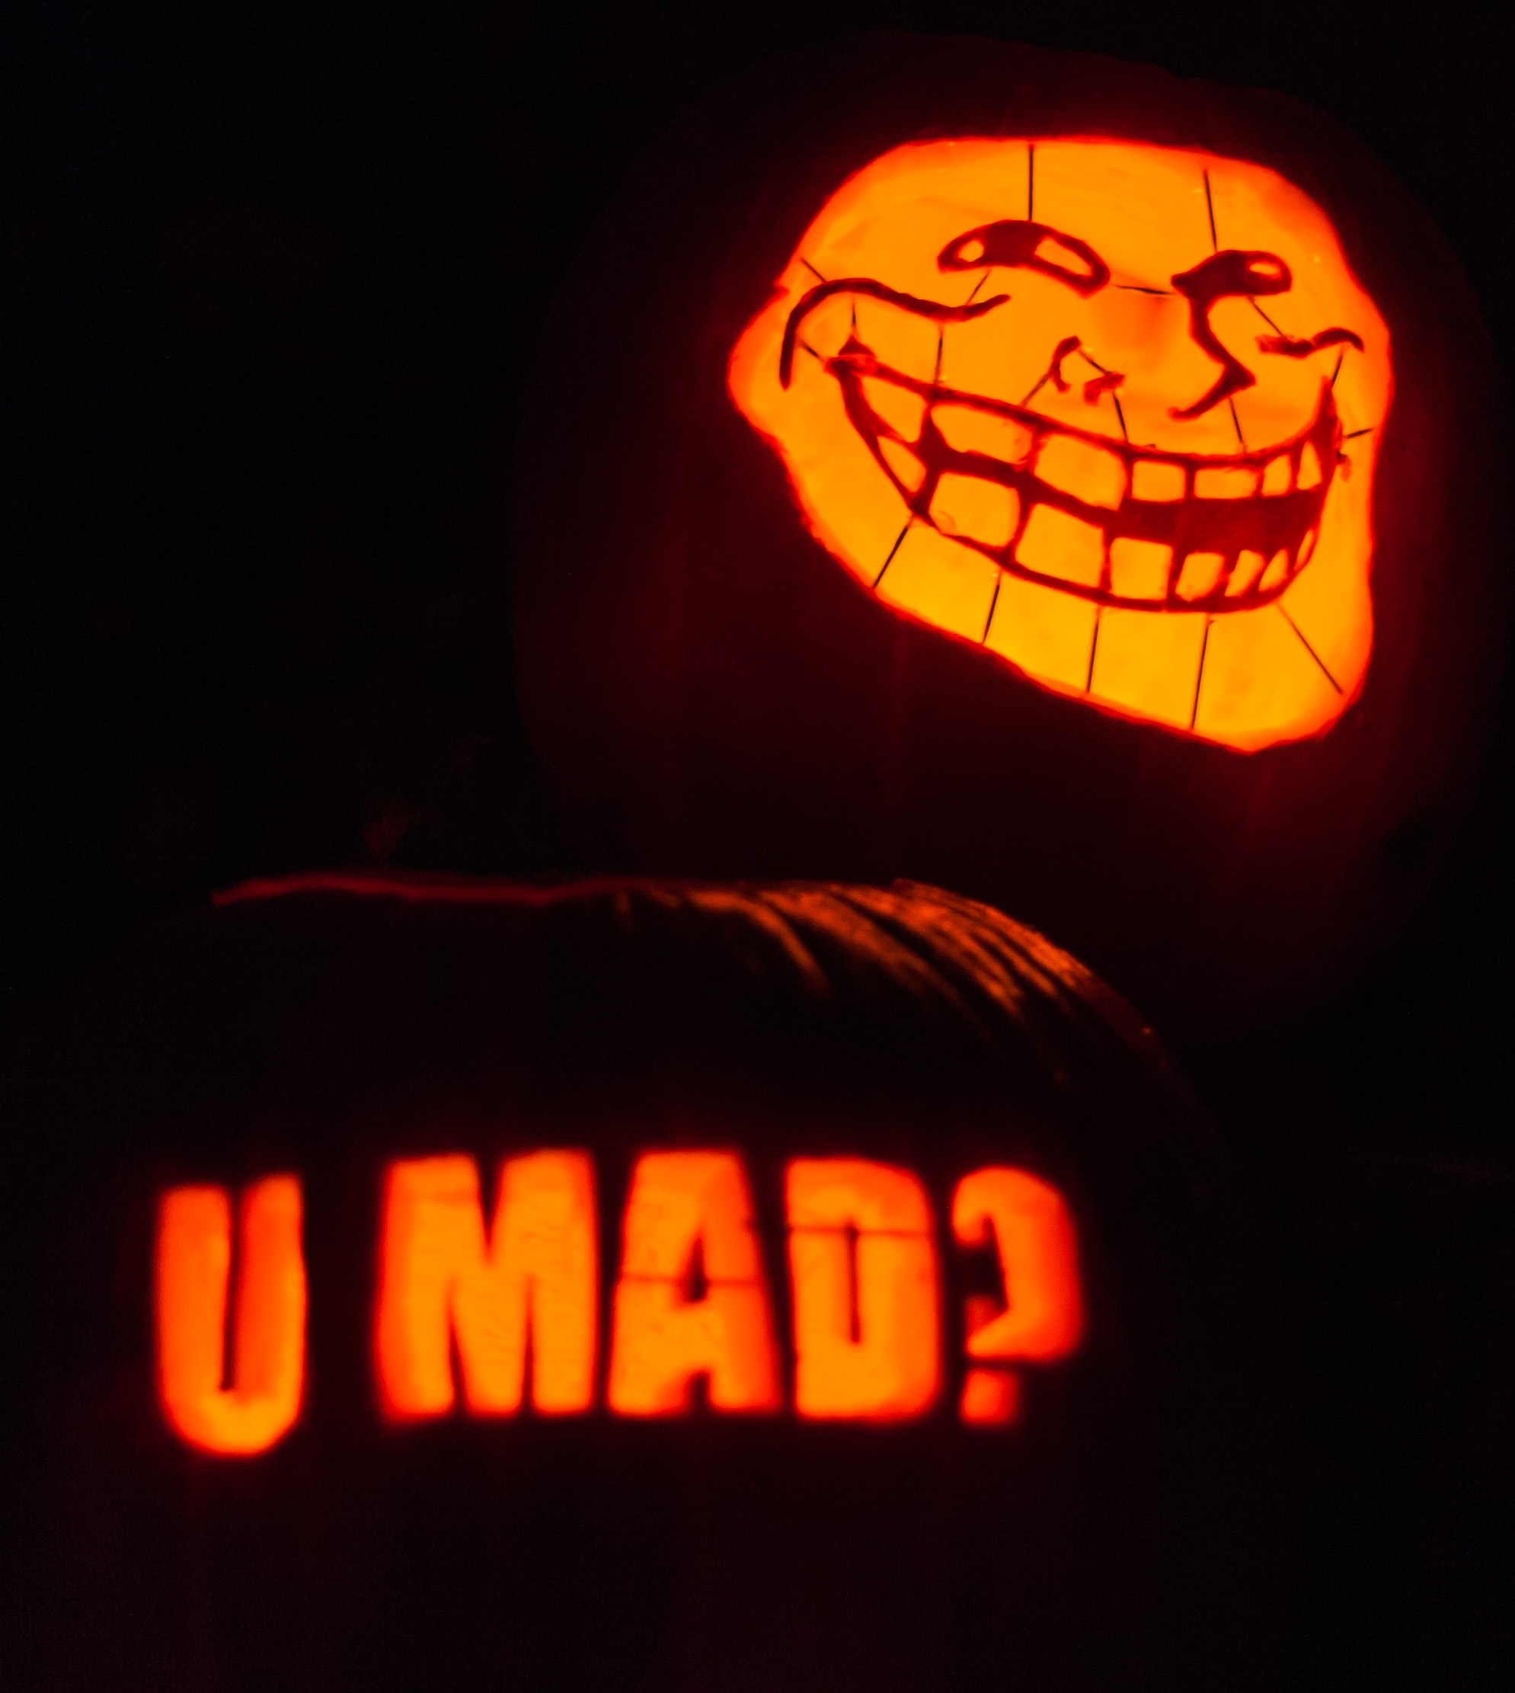
Known Harassers
Not just internet trolls
Stalkers do show up
Power plays & disruption
Have a mitigation plan
Strict confidentiality plan
Ensure attendee safety
CC BY Paul VanDerWerf

